Slide 1
Chapter 4: Multithreaded Programming

Slide 2
Chapter 4: Multithreaded Programming
Overview
Multicore Programming
Multithreading Models
Thread Libraries
Implicit Threading
Threading Issues

Slide 3
Objectives
To introduce the notion of a thread—a fundamental unit of CPU utilization that forms the basis of multithreaded computer systems
To discuss the APIs for the Pthreads, Windows, and Java thread libraries
To explore several strategies that provide implicit threading
To examine issues related to multithreaded programming
To cover operating system support for threads in Windows and Linux

Slide 4
Motivation
Most modern applications are multithreaded
Threads run within application
Multiple tasks with the application can be implemented by separate threads
Update display
Fetch data
Spell checking
Answer a network request
Process creation is heavy-weight while thread creation is light-weight
Can simplify code, increase efficiency
Kernels are generally multithreaded

Slide 5

Microsoft Word Spell Checking

Slide 6
Single and Multithreaded Processes

Slide 7
Count number of key pressed in a second

Slide 8
Keyhit Rating – No Thread
key_hit_count = 0
last_second_count = 0
t0 = current timestamp
While not stop:
Check keyboard or timeout in 9,5 seconds
If there is a key hit:
increase key_hit_count by one
t1 = current timestamp
if t1 – t0 >= 1 second:
key_hit_last_second = key_hit_count – last_second_count
rate = key_hit_last_second / (t1 – t0)
print rate
last_second_count = key_hit_count
t0 = t1

Slide 9
Keyhit Rating – Two Threads
Key_count_thread:
While not stop:
Wait for keyhit
increase key_hit_count by one
Rating_thread:
While not stop:
sleep for 1 second
key_hit_last_second = key_hit_count – last_second_count
rate = key_hit_last_second / (t1 – t0)
print rate
last_second_count = key_hit_count
Main:
key_hit_count = 0
last_second_count = 0
Start Rating_thread
Start Key_count_thread

Slide 10
Multithreaded Server Architecture

Slide 11
Process/Thread Creation Overheads
Iterations | Process | Thread
10 | 3633.80 | 87.80
20 | 6947.80 | 168.20
30 | 10501.00 | 269.80
40 | 14135.00 | 359.40
50 | 18693.00 | 470.60

Slide 12
Benefits
Responsiveness – may allow continued execution if part of process is blocked, especially important for user interfaces
Resource Sharing – threads share resources of process, easier than shared memory or message passing
Economy – cheaper than process creation, thread switching lower overhead than context switching
Scalability – process can take advantage of multiprocessor architectures

Slide 13
Multicore Programming
Multicore or multiprocessor systems putting pressure on programmers, challenges include:
Dividing activities
Balance
Data splitting
Data dependency
Testing and debugging
Parallelism implies a system can perform more than one task simultaneously
Concurrency supports more than one task making progress
Single processor / core, scheduler providing concurrency
Types of parallelism
Data parallelism – distributes subsets of the same data across multiple cores, same operation on each
Task parallelism – distributing threads across cores, each thread performing unique operation
As # of threads grows, so does architectural support for threading
CPUs have cores as well as hardware threads
Consider Oracle SPARC T4 with 8 cores, and 8 hardware threads per core

Slide 14
Concurrency vs. Parallelism
Concurrent execution on single-core system:
Parallelism on a multi-core system:

Slide 15
Multi-Threading Performance

Slide 16
User Threads and Kernel Threads
User threads - management done by user-level threads library
Three primary thread libraries:
POSIX Pthreads
Win32 threads
Java threads
Kernel threads - Supported by the Kernel
Examples – virtually all general purpose operating systems, including:
Windows
Solaris
Linux
Tru64 UNIX
Mac OS X

Slide 17
Multithreading Models
Many-to-One
One-to-One
Many-to-Many

Slide 18
Many-to-One
Many user-level threads mapped to single kernel thread
One thread blocking causes all to block
Multiple threads may not run in parallel on muticore system because only one may be in kernel at a time
Few systems currently use this model
Examples:
Solaris Green Threads
GNU Portable Threads

Slide 19
One-to-One
Each user-level thread maps to kernel thread
Creating a user-level thread creates a kernel thread
More concurrency than many-to-one
Number of threads per process sometimes restricted due to overhead
Examples
Windows NT/XP/2000
Linux
Solaris 9 and later

Slide 20
Many-to-Many Model
Allows many user level threads to be mapped to many kernel threads
Allows the operating system to create a sufficient number of kernel threads
Solaris prior to version 9
Windows NT/2000 with the ThreadFiber package

Slide 21
Two-level Model
Similar to M:M, except that it allows a user thread to be bound to kernel thread
Examples
IRIX
HP-UX
Tru64 UNIX
Solaris 8 and earlier

Slide 22
Thread Libraries
Thread library provides programmer with API for creating and managing threads
Two primary ways of implementing
Library entirely in user space
Kernel-level library supported by the OS

Slide 23
Pthreads
May be provided either as user-level or kernel-level
A POSIX standard (IEEE 1003.1c) API for thread creation and synchronization
Specification, not implementation
API specifies behavior of the thread library, implementation is up to development of the library
Common in UNIX operating systems (Solaris, Linux, Mac OS X)

Slide 24
Implicit Threading
Growing in popularity as numbers of threads increase, program correctness more difficult with explicit threads
Creation and management of threads done by compilers and run-time libraries rather than programmers
Three methods explored
Thread Pools
OpenMP
Grand Central Dispatch
Other methods include Microsoft Threading Building Blocks (TBB), java.util.concurrent package

Slide 25
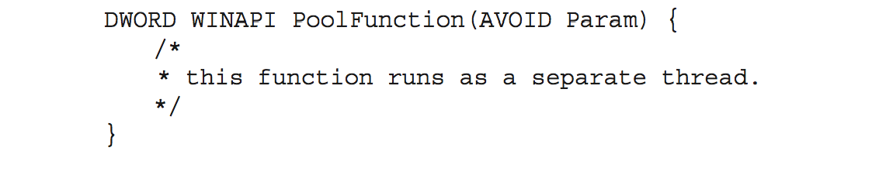
Thread Pools
Create a number of threads in a pool where they await work
Advantages:
Usually slightly faster to service a request with an existing thread than create a new thread
Allows the number of threads in the application(s) to be bound to the size of the pool
Separating task to be performed from mechanics of creating task allows different strategies for running task
i.e.Tasks could be scheduled to run periodically
Windows API supports thread pools:

Slide 26
Threading Issues
Semantics of fork() and exec() system calls
Signal handling
Synchronous and asynchronous

Slide 27
Semantics of fork() and exec()
Does fork()duplicate only the calling thread or all threads?
Some UNIXes have two versions of fork
Exec() usually works as normal – replace the running process including all threads

Slide 28
Signal Handling
Signals are used in UNIX systems to notify a process that a particular event has occurred.
A signal handler is used to process signals
Signal is generated by particular event
Signal is delivered to a process
Signal is handled by one of two signal handlers:
default
user-defined
Every signal has default handler that kernel runs when handling signal
User-defined signal handler can override default
For single-threaded, signal delivered to process
Where should a signal be delivered for multi-threaded?
Deliver the signal to the thread to which the signal applies
Deliver the signal to every thread in the process
Deliver the signal to certain threads in the process
Assign a specific thread to receive all signals for the process

Slide 29
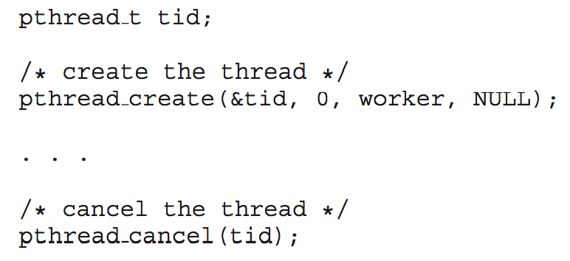
Thread Cancellation
Terminating a thread before it has finished
Thread to be canceled is target thread
Two general approaches:
Asynchronous cancellation terminates the target thread immediately
Deferred cancellation allows the target thread to periodically check if it should be cancelled
Pthread code to create and cancel a thread:

